Slide 1



WEATHER FORCASTING
PRESENTED BY
David Osama Mariam Ibrahim
Basmala Tarek
NancyKhaled Shahd Mohamed

Slide 2

INTRODUCTION
Our Weather Forecasting App is designed to provide real-time weather updates with a user-friendly interface. It allows users to search for weather information by city using reliable API data.

Slide 3

FEATURES
Get data using API
Hourly Forcasting
Real-time weather updates
Daily Forcasting

Slide 4

FEATURES CONT.
Change temperature between F and C
Theme changed based on weather condition
Get weather by city

Slide 5


ARCHITECTURE & TECHNOLOGY
Frontend
Backend
API
Flutter
REST APIs for weather data
OpenWeatherMap API

Slide 6
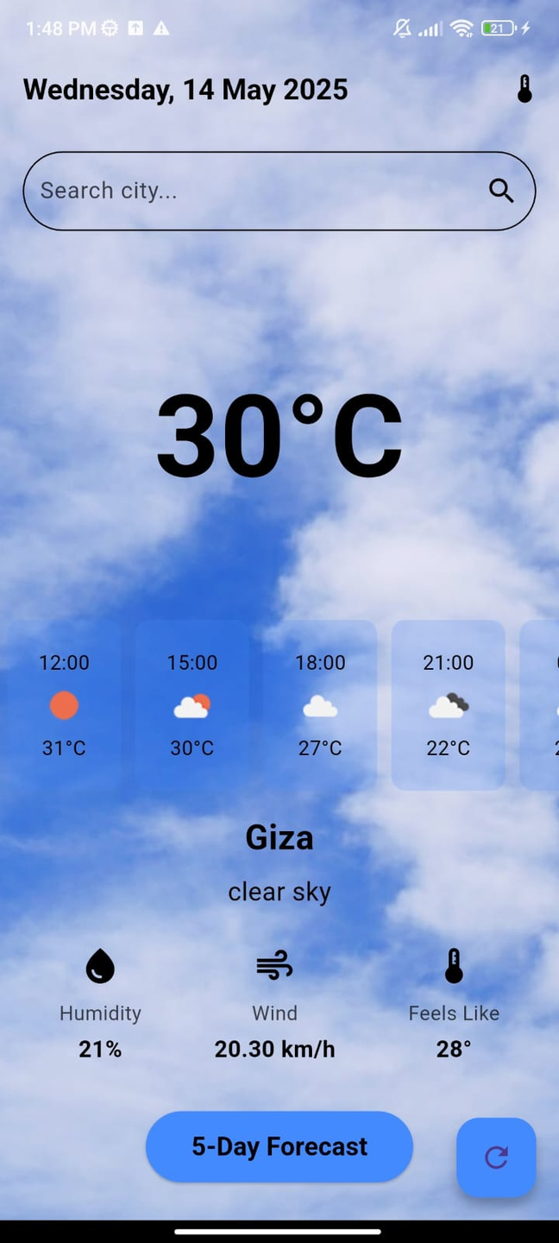

Slide 7
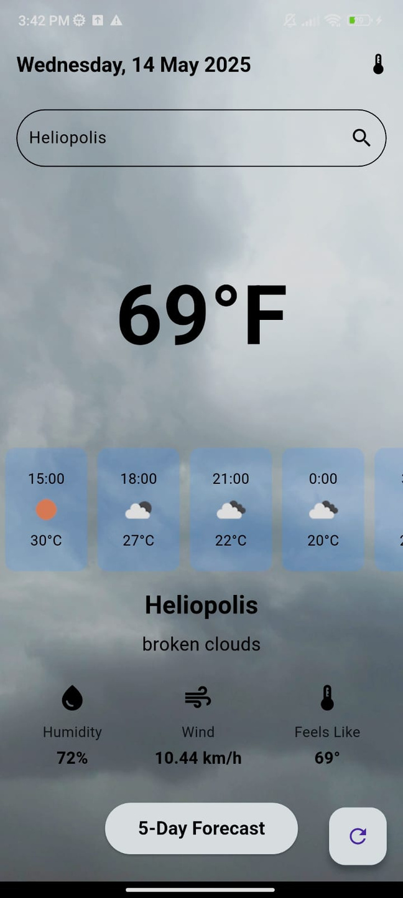

Slide 8
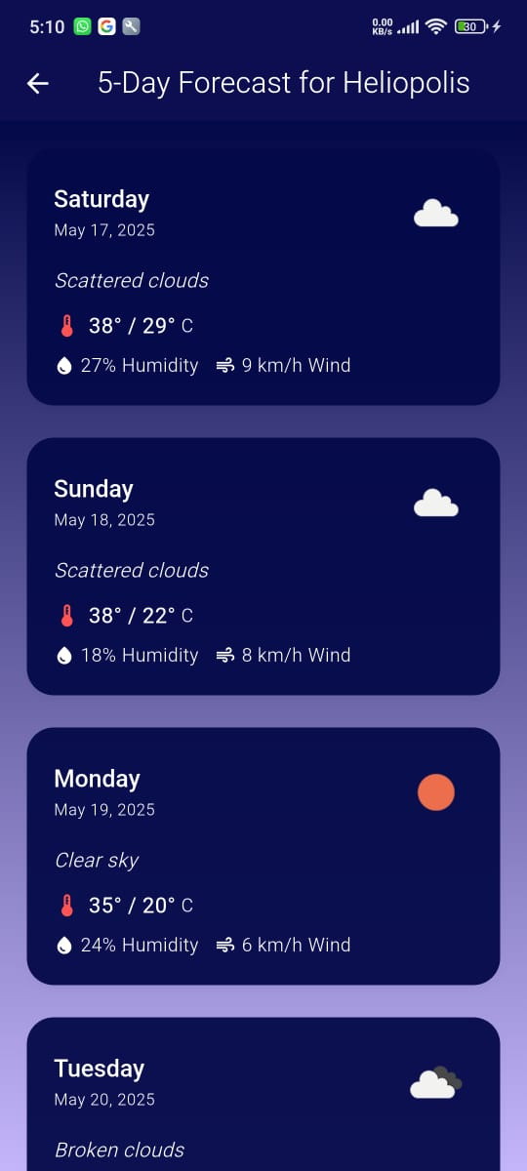

Slide 9
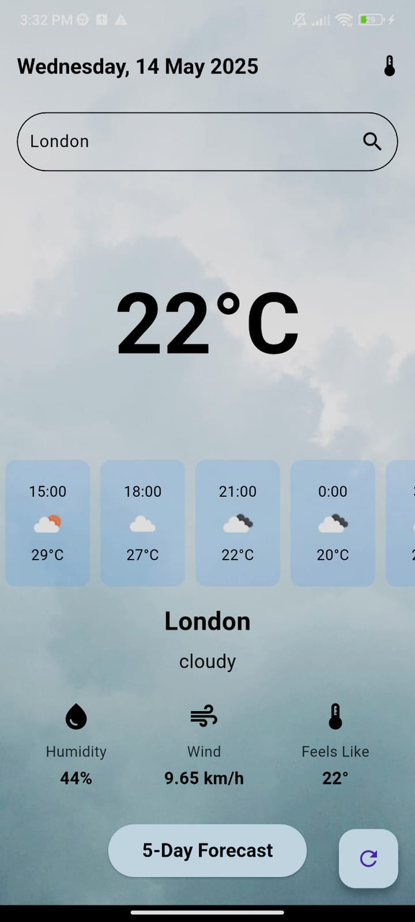

Slide 10
Thank you!

